Slide 1

Minor Project 6th Semester
Project Title:
Switching System for Computer Labs
Submitted By:
Mayank Jatav - 0208CS171060
Aman Verma - 0208CS171009
Jatin Chawla - 0208CS171053
Department of Computer Science
Gyan Ganga College of Technology
Jabalpur, Madhya Pradesh

Slide 2
Problem Description:-
The PC’s in our computer labs are currently connected in such a way that every PC need to be Shut Down manually.
The Switches of each individual PC need to be turned off manually.
Doing such a tedious task is very difficult and annoying for the lab attendants.
It becomes very difficult to check and power off each PC manually.
It also consumes a lot of useful time.
So there is a need for a system by which all PC’s could be turned off from one place easily without going and checking each PC’s.

Slide 3
Case Study:-
Why we choose this project?
Ans. We choose this project because it was interesting and really required for the labs.
Is there any similar project in the market and it’s study?
There is a similar project also in the market, Smart Tubelight, made by Altruism Lab. This app allows the user to power off the different appliances. This app can only be used to cut the power supply of the PCs. But our app also provide the facility to shut down the PCs before cutting the power supply.
Who will be your target audience?
Our target audience include different organizations such as Schools, Offices, etc. The system could be installed in different labs and could also be easily controlled using our app.
What will be the benefits of your project to the society?
Our project will allow the lab attends to manage the power and switch functionality of the PCs from one place. So it will save a lot of time. PCs could be managed only when the are in same network, therefore there are less chances for system to be hijacked.

Slide 4
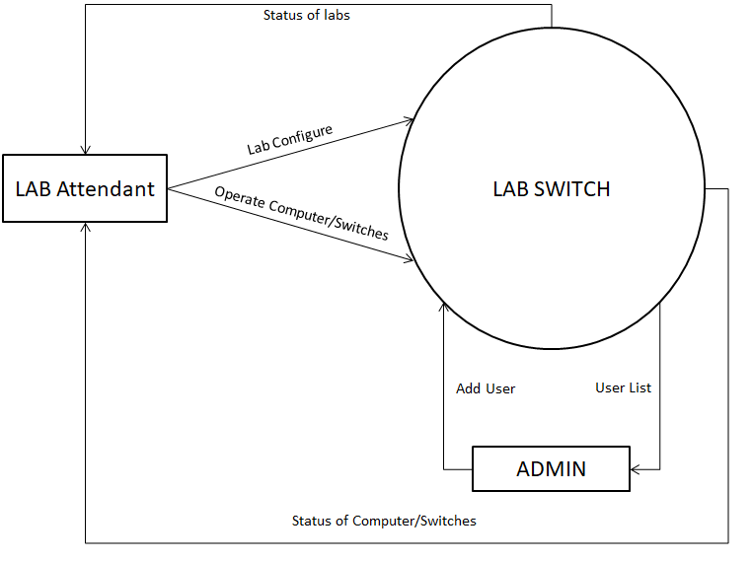
Data Flow Diagram – Level 0

Slide 5
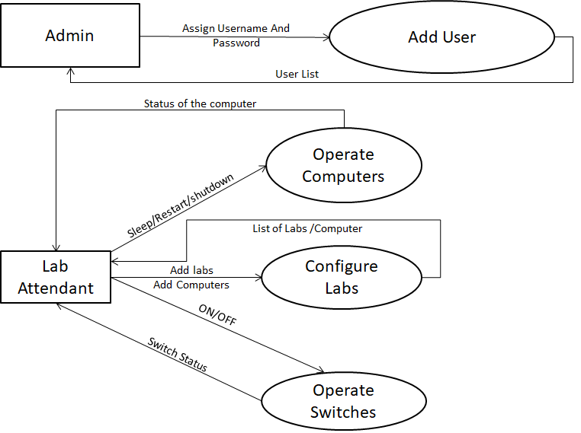
Data Flow Diagram – Level 1

Slide 6
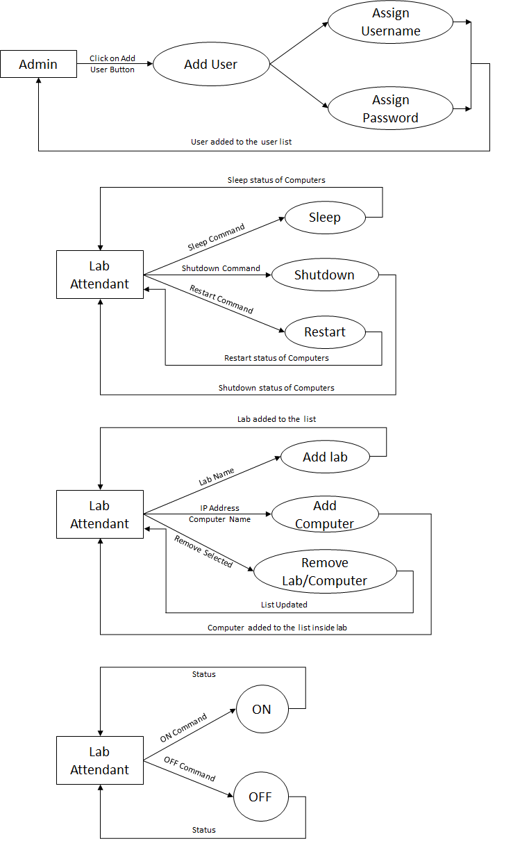
Data Flow Diagram – Level 2

Slide 7
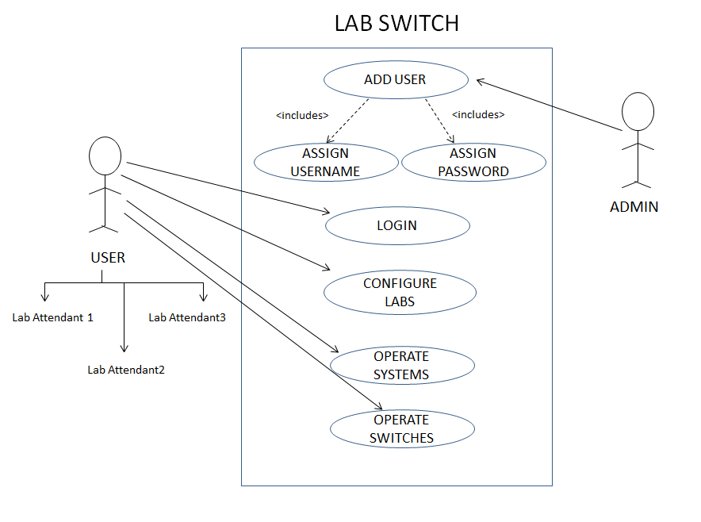
Use Case Diagram:
Whole System

Slide 8
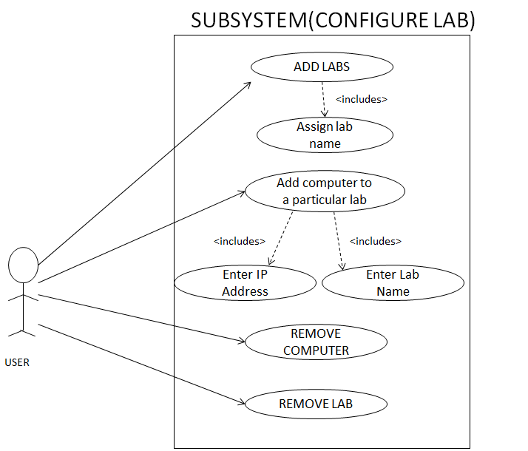
Use Case Diagram:
Configure Lab

Slide 9
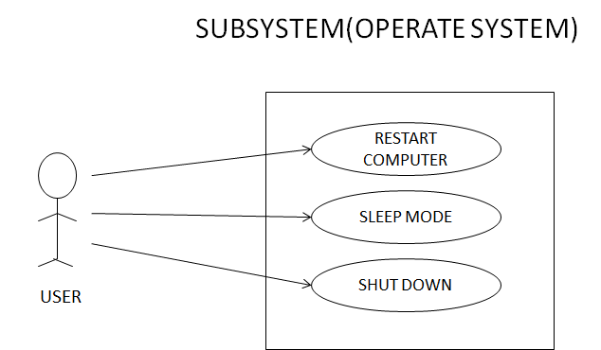
Use Case Diagram:
Operate PCs

Slide 10
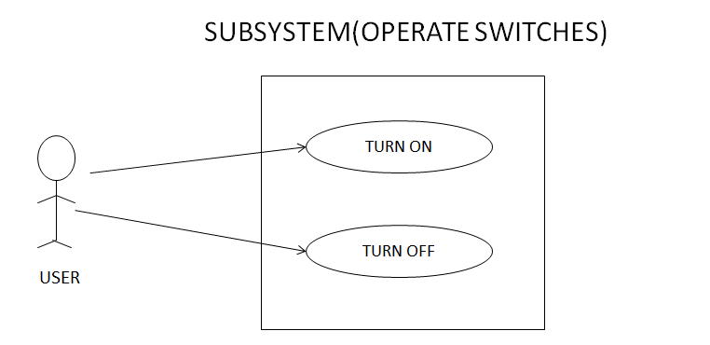
Use Case Diagram:
Operate Switches

Slide 11
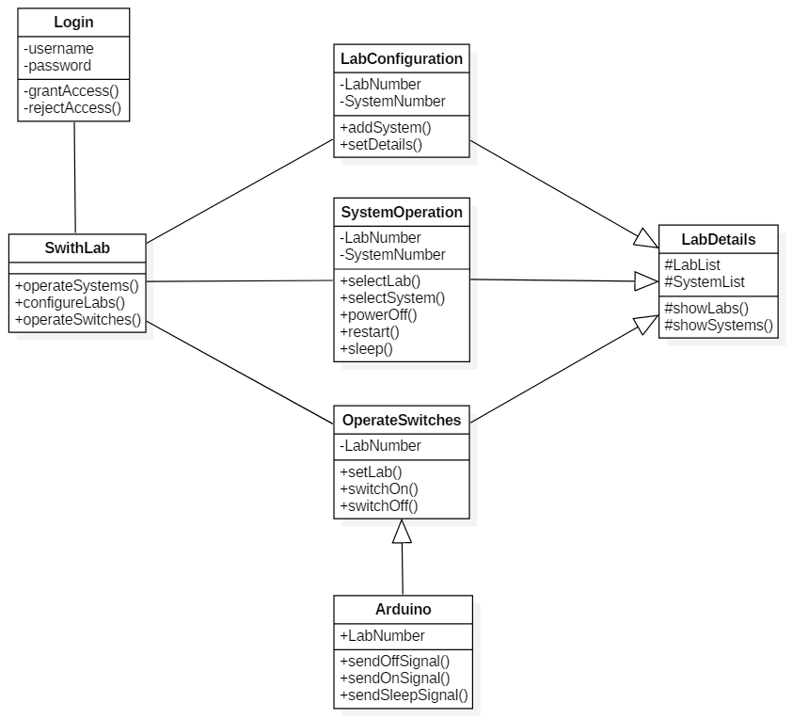
Class Diagram:

Slide 12
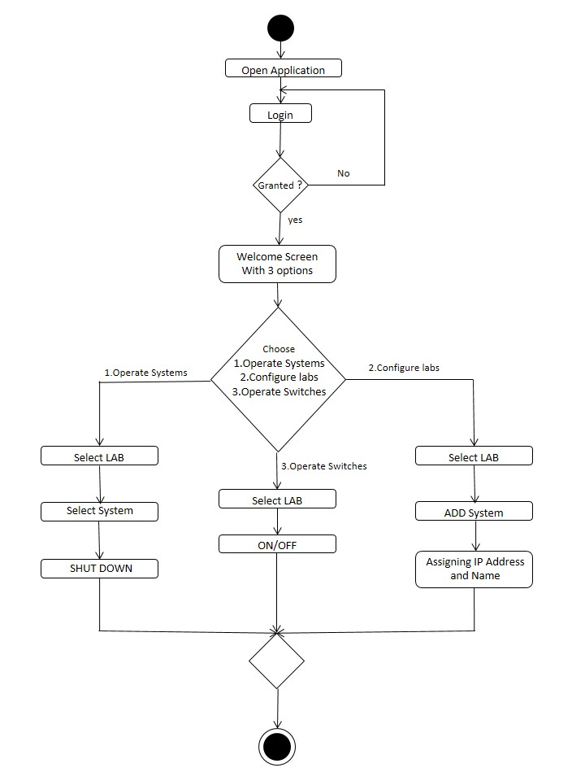
Activity Diagram:

